Slide 1
Special Playtime for Parents & Caregivers
Presentation by:
Beth Richey, LCSW, RPT-S &
Tammi Van Hollander, LCSW, RPT-S

Slide 2
What can Special Playtime help nurture?
Lower Anxiety
Strengthen Parent-Child Bond
Increase Self Esteem
Reduce Tantrums
Reduce Sibling Jealousy
Increase Creativity

Slide 3
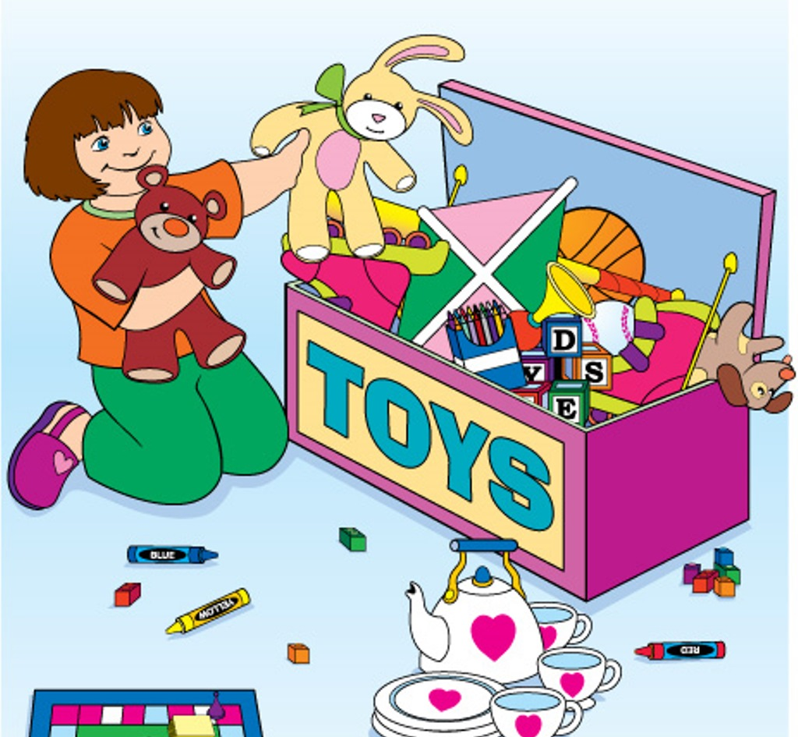
Why Play?
Play is the language of children!
Play is how kids make sense of the world
Why Me?
“You are your child’s most important toy”
You are the most important presence in your child’s world
Your presence, connection, and love are super powers!

Slide 4
Kids don’t have a lot of control over their lives, and often feel a lack of power
Kids sometimes hear lots of corrections and negativity about themselves and their behaviors
When tanks are low you will see more acting out and connection seeking behaviors
When tanks are filled
you will see your child’s best self
LOVE TANK
POWER TANK

Slide 5
What makes Special Playtime different?
The child leads the play. They are“Play Boss”
Parent and child play one-on-one
Unplug (silence phones, turn off TV)
Scheduled daily for a set time (10 to 30 min)
Play focuses on toys without rules
Caregivers use specific engagement techniques

Slide 6
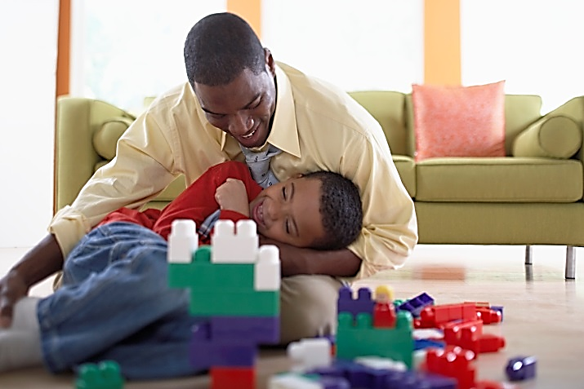
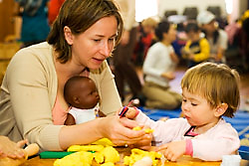
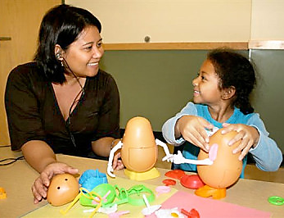
Activities & Supplies
Focus on imaginative toys that encourage creativity and free play
Avoid: Toys with rules, board games, books, or activities with stressful messes
Dolls, Building Blocks, LEGOs, Toy Cars, Toy Animals, Arts and Crafts, Play Food, Play-Doh

Slide 7
Follow their Lead -Stick with their play themes -Let the child decide the activity Reflection -Repeat or paraphrase what your child says -Say what you are seeing, avoid interpretation Attunement -Match child’s intensity Praise -Use specific praises for positive behavior Have Fun -Be genuine ☺ -Be in a good headspace
Engagement
Skills

Slide 8
Asking Questions
Lots of questions can sometime make children feel like adults are not listening to them. Adults ask kids SO MANY QUESTIONS, kids need a break sometimes
AVOID
“What color is that car?” “What are you building?” “Why did you do that?”
2. Giving Commands
This takes the attention and control away from the child.
“Draw your letters” “No, do it this way.” “You should build the tower like this.”
3. Criticizing/Correcting
Keep it positive! Avoid correcting or criticizing your child.
“You’re doing that wrong” “You should do it like this.” “That’s a bad idea”
4. Remember to Stay in the Play
Don’t make it a learning lesson.

Slide 9
Selective Attention
Handling Problem Behaviors During Special Playtime
Ignore!
Ignore!
Ignore!
Ignore!
Ignore!
Ignore!
1. IGNORE: Whining, sassing, and other disruptive/irritating behaviors.
2.“Pause & Pounce” As soon as your child stops the irritating behavior, praise the positive behavior they are doing. “I like how you are sitting on the floor with me.” “I like how you are using a quiet voice”

Slide 10
I tried to teach my child with books:
he gave me only puzzled looks.
I tried to teach my child with words:
they passed him by often unheard.
Despairingly, I turned aside;
“How shall I teach this child?”
I cried.
Into my hand
he put the key;
“Come,” he said,
“PLAY WITH ME!”
-Anonymous

Slide 11
For more resources visit: www.MainlinePlayTherapy.com & www.BethRicheyCounseling.com

Slide 12
References
Bratton, S., & Landreth, G. (n.d.). Provide Emotional Support to Play Therapy Clients Via Telehealth with Parents. Retrieved April 26, 2020, from https://cdn.ymaws.com/www.a4pt.org/resource/resmgr/telehealth/2_-_Provide_Emotional_Suppor.pdf
Glasser, H., & Block, M. (2016). The transforming the intense child workbook: an experiential guide for parents, educators and therapists for learning and implementing the nurtured child approach. Tucson, AZ: Nurtured Heart Publications.
Guerney, L. (2000). Filial therapy into the 21st century. International Journal of Play Therapy, 9(2), 1-17. https://doi.org/10.1037/h0089433
McNeil, C. B., & Hembree-Kigin, T. L. (2011). Parent-child interaction therapy. New York: Springer.
All text ©2020 B. Richey & T. Van Hollander

